Slide 1
Versioned Distributed Arrays for Resilience in Scientific Applications: Global View Resilience
Andrew A. Chien, The University of Chicago and Argonne National Laboratory
ICCS 2015, June 1
Reykjavik, Iceland

Slide 2
Outline
GVR Approach and Flexible Recovery
GVR in Applications Programming Effort
GVR Versioning and Recovery Performance
Summary
...More Opportunities with Versioning

Slide 3
GVR Approach
Global-view Data
Data-oriented Resilience
Applications
System
Application-System Partnership: System Architecture
Exploit algorithm and application domain knowledge
Enable “End to end” resilience model (outside-in), Levis’ Talk
Portable, Flexible Application control (performance)
Direct Application use or higher level models (task-parallel, PGAS, etc.)
GVR Manages storage hierarchy (memory, NVRAM, disk)
GVR ensures data storage reliability, covers error types
Incremental “Resilience Engineering”
Gentle slope, Pay-more/Get-more, Anshu’s talk
Resilience
Effort
Notes:
Enable “Outside-in” Incremental Adoption by software architects
Coarse-grain, evolving to finer as needed
Portable, application expression of resilience needs
Efficient : high degrees of parallelism with low overhead and flexible coverage
Interfaces and semantics; interaction with application/code experts
New techniques, technologies and architectures; performance experiments, etc.

Slide 4
Data-oriented Resilience based on Multi-versions
Phases create new
logical versions
Checking,
Efficient coverage
App-semantics
based recovery
Global-view data – flexible recovery from data, node, other errors
Versioning/Redundancy customized as needed (per structure)
Error checking & recovery framed in high-level semantics (portable)

Slide 5
GVR Concepts and API
Create Global view structures
New, federation interfaces
GDS_alloc(...), GDS_create(...)
Global view Data access
Data: GDS_put(), GDS_get()
Consistency: GDS_fence(), GDS_wait(),...
Accumulate: GDS_acc(), GDS_get_acc(), GDS_compare_and_swap()
Versioning
Create: GDS_version_inc(), Navigate: GDS_get_version_number(), GDS_move_to_newest(), ...
Error handling
Application checking, signaling, correction: GDS_raise_error(), GDS_register_local_error_handler()...
System signaling, integrated recovery: GDS_raise_error(), GDS_resume()
Put
Get
Put
Check
Error
Repair
Applications have portable control over coverage and overhead of resilience.

Slide 6
GVR Flexible Recovery I
Immediate errors: Rollback
Latent/Silent errors: multi-version
Application recovery using multiple streams
Immediate + Latent: novel forward error recovery
System or application recovery using approximation, compensation, recomputation, or other techniques
Tune version frequency, data structure coverage, increased ABFT and forward error recovery for rising error rates
Immediate: rollback
Latent: fail
CR
Immediate: rollback
Latent: rollback
GVR:
Multi-version
Multi-stream
Immediate + Latent:
Forward Error recovery

Slide 7
GVR Flexible Recovery II
Complex errors, Rollback-diagnosis-forward
Flexible, Application-based recovery
Walk multiple versions
Diagnose
Compute corrections/approximations, execute forward
Complex errors, Forward from multiple versions
Flexible, Application-based recovery
Partial materialization of multiple versions
Compute approximations, execute forward
Tune version frequency, data structure coverage, increased ABFT and forward error recovery for rising error rates
Recovered
Application
Recovered
Application
GVR flexibility enables scalability across a wide range of error types and rates.

Slide 8
GVR Basic APIs
/* Add matrices C = A + B */
GDS_size_t counts[] = {N, N};
GDS_size_t lo[2], hi[2];
GDS_size_t ld[1] = N;
GDS_size_t min_chunk[2] = {1, N};
GDS_alloc(2 /*2-D*/, counts, min_chunk,
GDS_DATA_DBL, GDS_PRIORITY_HIGH,
GDS_COMM_WORLD, MPI_INFO_NULL, &gds_A);
/* Same for gds_B and gds_C */
/* Initialize A and B */
lo[0] = me; lo[1] = 0;
hi[0] = me; hi[1] = N-1;
GDS_get(my_A, ld, lo, hi, gds_A);
GDS_get(my_B, ld, lo, hi, gds_B);
GDS_wait(gds_A); GDS_wait(gds_B);
for (j = 0; j < N; j++)
my_C[j] = my_A[j] + my_B[j];
GDS_put(my_C, ld, lo, hi, gds_C);
GDS_fence(gds_C);
Create 2-dimensional global arrays
Specifies a region to access from this process: process i accesses row i
Wait for non-blocking operations to complete
Global synchronization

Slide 9
GVR Versioning
/* Main computation loop */
do {
sprintf(label, “version %d”, i);
do_computation(gds);
GDS_version_inc(gds, 1,label, strlen(label));
} while (!converged);
User-defined label for version
Take current snapshot and increment version
Make a cloned handle to the array for navigating versions
/* Roll back from a correct version */
GDS_descriptor_clone(gds, &gds_clone);
do {
GDS_move_to_prev(gds_clone);
} while (verify_contents(gds_clone) != OK);
GDS_get(buff, ld, lo, hi, gds_clone);
GDS_put(buff, ld, lo, hi, gds);
GDS_free(&gds_clone);
Search for a correct version
Copy old and correct data to the current version
Multiple versions enable more sophisticated recovery.

Slide 10
Simple Version Recovery: Preconditioned Conjugate Gradient
A= ...
Version x “solution vector”
Restore x on error
Version p “direction vector”
Restore on error
Version A “linear system”
Restore on error
Restore from which version?
Most recent (immediately detected errors)
Older version (latent or “silent” errors)

Slide 11
Multi-stream in PCG: Matching redundancy to need
A
0
Low redundancy
x
0
1
2
3
4
5
6
High redundancy
p
0
1
2
3
Medium redundancy
Iteration
1
2
3
4
5
6
Notes:
A is the system being solved
X is the solution vector
P is the search direction
Not shown is M the preconditioner and R the residual

Slide 12
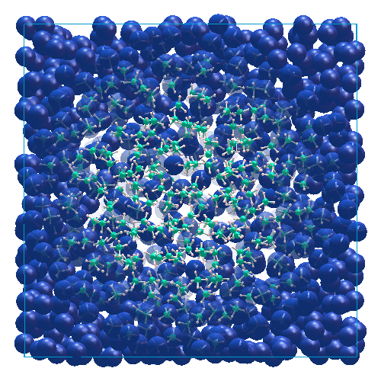
Molecular Dynamics: miniMD, ddcMD
miniMD: a SNL mini-app, a version of LAMMPS
ddcMD is the atomistic simulation developed by LLNL -- scalable and efficient.
LLNL (Dave Richards & Ignacio Laguna)
Notes:
Example: handling L1 cache errors and dram uncorrectable errors in the same fashion (same application code)
The system oriented view is quite different, but the application-oriented view is the same

Slide 13
ddcMD + GVR
main() { /* store essential data structures in gds */ GDS_alloc(&gds); /* specify recovery function for gds */ GDS_register_global_error_handler(gds, recovery_func); simulation_loop() { computation(); error = check_func() /* finds the errors */ if (error) { error_descriptor = GDS_create_error_descriptor(GDS_ERROR_MEMORY) /* signal error */ /* trigger the global error handler for gds */ GDS_raise_global_error(gds, error_descriptor); } if (snapshot_point){GDS_version_inc(gds); GDS_put(local_data_structure, gds);}; } } /* Simple recovery function, rollback */ recovery_func(gds, error_desc) { /* Read the latest snapshot into the core data structure */ GDS_get(local_data_structure, gds); GDS_resume_global(gds, error_desc); }
A. Fang, I. Laguna, D. Richards, and A. Chien. “Applying GVR to molecular dynamics: ...” CS TR-2014-04, Univ of Chicago.
Notes:
Aiman Fang and Andrew A. Chien. Applying gvr to molecular dynamics: Enabling resilience for scientific computations. Technical Report TR-2014-04, Department of Computer Science, University of Chicago, April 2014.

Slide 14
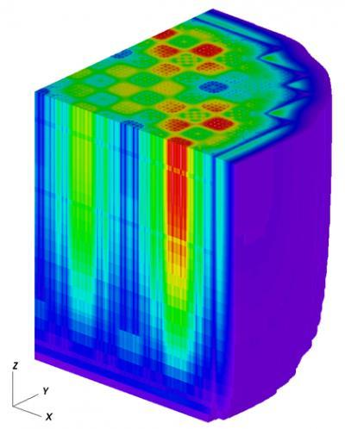
Monte Carlo Neutron Transport (OpenMC)
High fidelity, computation intensive and large memory (100GB~ cross sections and 1TB~ tally data)
Particle-based parallelization is used with data decomposition
Partition tally data by global array
OpenMC: best scaling production code
DOE CESAR co-design center “co-design application”
ANL/CESAR (Siegel, Tramm)

Slide 15
OpenMC + GVR
Initialize initial neutron positions
GDS_create(tally & source_site); //Create global tally array and source sites
for each batch
for each particle in batch
while (not absorbed)
move particle and sample next interaction
if fission
GDS_acc(score, tally) // tally, add score asynchronously
add new source sites
end
GDS_fence() // Synchronize outstanding operations resample source sites & estimate eigenvalue
if (take_version) GDS_ver_inc(tally) // Increment version
GDS_ver_inc(source_site) // Increment version
end
end
Create Global view tallies
Versioning: 259 LOC (<1%)
Forward recovery: 250 (<1%)
Overall application: 30 KLOC
Notes:
How many for version recovery?

Slide 16

Monte Carlo “Compensating” Forward Error Recovery
Latent or
current
Error detected
Monte Carlo Simulation
“Random” Sample
Computation
Convergence?
Corrupt Tally
Statistics
Recovery
Vn
Vn-1
=
Batch
Corrupt Tally
=
Good Tally
Initial
Tally
Continue
Sampling
Tally
Tally
Good
Tally
Versions

Slide 17
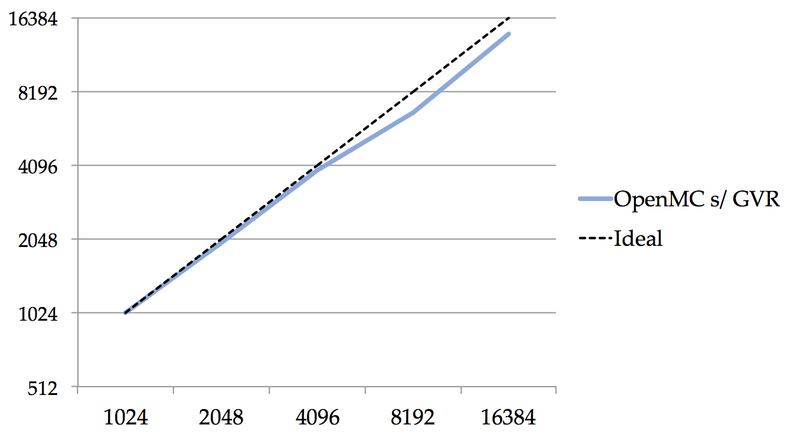
OpenMC+GVR Performance
New record scaling
for OpenMC !!
(ranks)
N. Dun, H. Fujita, J. Tramm, A. Chien, and A. Siegel. Data Decomposition in Monte Carlo Neutron Transport Simulations using Global View Arrays, IJHPCA, May 2014
Notes:
Versioning off

Slide 18
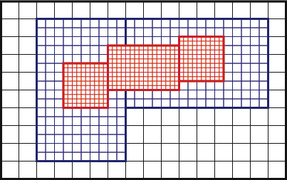
Chombo + GVR
Resilience for core AMR hierarchy
Central to Chombo
Lessons applicable to Boxlib (ExaCT co-design app)
Multiple levels, each with own time-step
Data corruption and Process Crash Resilience
GVR used to version each level separately
Exploits application-level snapshot-restart
GVR as vehicle to explore cost models for “resilience engineering” (Dubey)
Future: customize or localize recovery
ExReDi/LBNL (Dubey, Van Straalen)
Notes:
Credit Anshu Dubey and Brian Van Straalen of LBNL

Slide 19
GVR Gentle Slope
Code/Application | Size (LOC) | Changed (LOC) | Leverage Global View | Change SW architecture
Trilinos/PCG | 300K | <1% | Yes | No
Trilinos/Flexible GMRES | 300K | <1% | Yes | No
OpenMC | 30K | <2% | Yes | No
ddcMD | 110K | <0.3% | Yes | No
Chombo | 500K | <1% | Yes | No
GVR enables a gentle slope to Exascale resilience
Notes:
Trilinos libraries ~3000 lines
Pcg 25 lines
Flexible gmres <30 lines
Openmc 450 lines
ddcMD 300 lines
Chombo 700 lines

Slide 20
GVR Performance (Overhead)
Varied version frequency, against the native program. All < 2%.
GVR performance scales over versions and partial materialization too!
Notes:
Experiments scaling all of these applications to 2048+ ranks

Slide 21
GVR Summary
Easy to add to an application
Flexible control and coverage
Flexible recovery (enables variety of forward techniques, approximations, etc.)
Low overhead
Efficient version restore (across versions)
Efficient incremental restore
All Portable!

Slide 22
Additional GVR Research

Slide 23
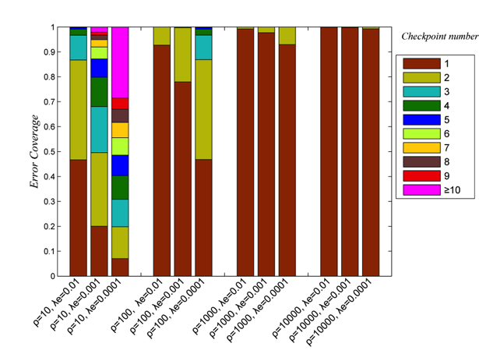
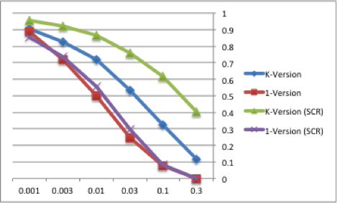
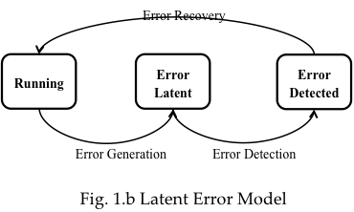
Latent Error Recovery
Latent or “silent” error model
Multi-version critical for difficult to detect errors
Multi-version increases efficiency
at high error rates
When multiple versions are useful
Impact on high-error rate regimes
Impact on difficult to detect errors
G. Lu, Z. Zheng, and A. Chien. When is multi-version checkpointing needed? 3rd Workshop on Fault-tolerance for HPC at extreme scale, FTXS ’13, 2013.

Slide 24
Efficient Versioning
Flat (Traditional)
Log-structured
Comparative Studies
with applications +
varied memory hierarchies
Different implementations (SW, HW, OS, Application)
OS page tracking, dirty bits, SW declared
Skewed and Multi-version in-memory representations
Efficient storage and materialization
Leverages collective view
Exploit NVRAM, burst buffers, etc.
H. Fujita, N. Dun, Z. Rubenstein, and A. Chien. Log-structured global array for efficient multi-version snapshots. CCGrid, May 2015.
H. Fujita, K. Iskra, P. Balaji, and A. Chien, "Empirical Characterization of Versioning Architectures", submitted.

Slide 25
N+1->N and N->N-1 Recovery
MPI Recovery (ULFM)
Application Process Recovery
Load Balancing and Performance
Post-recovery Efficiency (PRE)

Slide 26
GVR Software Status
Open source release, Oct 2014 (gvr.cs.uchicago.edu)
Tested with Miniapps – miniMD, miniFE experiments, and Full apps – ddcMD, PCG, OpenMC, Chombo
Features
Versioned distributed arrays with global naming (a portable abstraction)
Independent array versioning (each at its own pace)
Reliable storage of the versioned arrays in memory, local disk/ssd, or global file system (thanks to Adam and SCR team!)
Whole version navigation and efficient restoration
Partial version efficient restoration (partial “materialization”)
C native APIs and Fortran bindings
Runs on IBM Blue Gene, Cray XC, and Linux Clusters
Key: all of the application investment is portable because the abstractions are portable

Slide 27
More GVR Info I
Basic API’s and Usage
GVR Team. Gvr documentation, release 0.8.1-rc0. Technical Report 2014-06, University of Chicago, Department of Computer Science, 2014.
GVR Team. How applications use gvr: Use cases. Technical Report 2014-05, University of Chicago, Department of Computer Science, 2014.
GVR Architecture and Implementation Research
Hajime Fujita, Kamil Iskra, Pavan Balaji, and Andrew A. Chien, "Empirical Characterization of Versioning Architectures", in CLUSTER, October 2015.
A. Fang and A. Chien, "How Much SSD Is Useful for Resilience in Supercomputers”, in IEEE Symposium on Fault-tolerance at Extreme-Scale (FTXS), June 2015.
Hajime Fujita, Nan Dun, Zachary A. Rubenstein, and Andrew A. Chien. Log-structured global array for efficient multi-version snapshots. In CCGrid 2015..
Guoming Lu, Ziming Zheng, and Andrew A. Chien. When is multi-version checkpointing needed? In Proceedings of the 3rd Workshop on Fault-tolerance for HPC at extreme scale, ACM FTXS ’13, July 2013.
Wesley Bland, Aurelien Bouteiller, Thomas Herault, Joshua Hursey, George Bosilca, and JackJ. Dongarra. An evaluation of User-Level Failure Mitigation support in MPI. Computing, 95(12):1171–1184, 2013.

Slide 28
More GVR Info II
Application Studies
A. Chien, P. Balaji, N. Dun, A. Fang, H. Fujita, K. Iskra, Z. Rubenstein, Z. Zheng, J. Hammond, I. Laguna, D. Richards, A. Dubey, B. van Straalen, M Hoemmen, M. Heroux, K. Teranishi, A. Siegel. Exploring Versioning for Resilience in Scientific Applications: Global-view Resilience, submitted for publication, March 2015. (Best overall project summary)
A. Chien, P. Balaji, P. Beckman, N. Dun, A. Fang, H. Fujita, K. Iskra, Z. Rubenstein, Z. Zheng, R. Schreiber, J. Hammond, J. Dinan, A. Laguna, D. Richards, A. Dubey, B. van Straalen, M Hoemmen, M. Heroux, K. Teranishi, A. Siegel, and J. Tramm, "Versioned Distributed Arrays for Resilience in Scientific Applications: Global View Resilience", in International Conference on Computational Science (ICCS 2015), Reykjavik, Iceland, June 2015.
Nan Dun, Hajime Fujita, John R. Tramm, Andrew A. Chien, and Andrew R. Siegel. Data Decomposition in Monte Carlo Neutron Transport Simulations using Global View Arrays. Technical report, Computer Science, University of Chicago, IJHPCA, April 2014.
Aiman Fang and Andrew A. Chien. Applying gvr to molecular dynamics: Enabling resilience for scientific computations. Technical Report, Computer Science, University of Chicago, April 2014.
Zachary Rubenstein, Hajime Fujita, Ziming Zheng, and Andrew Chien. Error checking and snapshot-based recovery in a preconditioned conjugate gradient solver. Technical Report, Computer Science, University of Chicago, November 2013.
Ziming Zheng, Andrew A. Chien, and Keita Teranishi. Fault tolerance in an inner-outer solver: A gvr-enabled case study. In 11th International Meeting High Performance Computing for Computational Science VECPAR 2014, Oregon.

Slide 29
Acknowledgements
GVR Team: Hajime Fujita, Zachary Rubenstein, Aiman Fang, Nan Dun, Yan Liu (UChicago), Pavan Balaji, Pete Beckman, Kamil Iskra, (ANL), and application partners Andrew Siegel (Argonne/CESAR), Ziming Zheng (UC/Vertica), James Dinan (Intel), Guoming Lu (UESTC), Robert Schreiber (HP), Jeff Hammond (Argonne/ALCF/NWChem->Intel), Mike Heroux, Mark Hoemmen, Keita Teranishi (Sandia), Dave Richards (LLNL), Anshu Dubey, Brian Van Straalen (LBNL)
SCR Team – some elements included in GVR system (thanks!)
Department of Energy, Office of Science, Advanced Scientific Computing Research DE-SC0008603 and DE-AC02-06CH11357
For more information: http://gvr.cs.uchicago.edu/

